Slide 1
Source Deliverables
UMAY
2018, October 8th
Notes:
I am working in HW Industrialization group. Responsible from the source part of sensing.
I recently joined ASML, had experience with high power lasers that are used in military applications.

Slide 2
Myself
Born in Turkey
Istanbul Technical University
Aselsan A.S.
Laser Range Finders and Designators
ASML
IE Department
Source
OIM

Slide 3
Source Components
Source Layout
LPSU (LPPS Power Supply Unit)
LPPS (Laser Pumped Plasma Source)
CLM (Continuous Lambda Module)
Fibers
Useful tips (Case Study)
Notes:
So what are source components?
In this presentation:

Slide 4
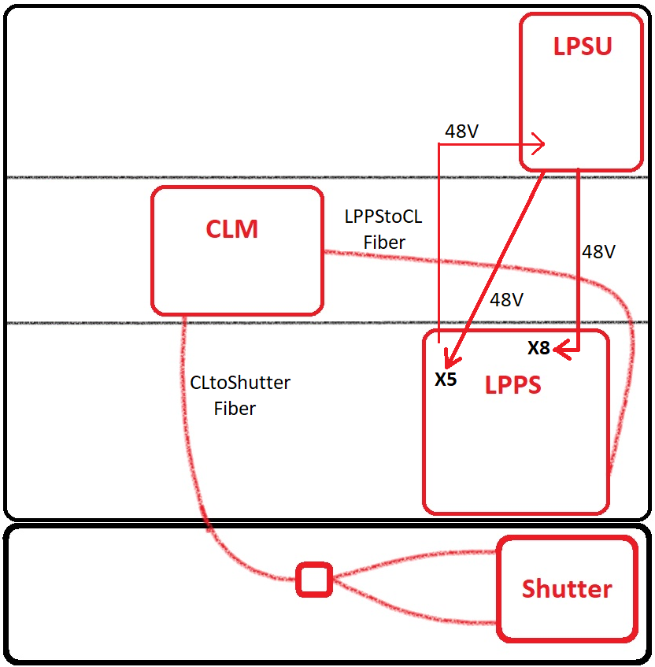
Source Layout
Light Processes
UCA
LPSU: Supplies the power needed by the Laser.
LPPS: Creates the white light out of the laser.
CLM: Lets the selected light to pass through with the help of color wheels (SWP and LWP)
Note: This layout is for the systems that use LPPS MK4 (375PEP and 380).
MMA
Notes:
Purpose of source is to deliver a specific light determined by the recipe to the sensor cameras.
LPSU supplies the electrical power needed by the LPPS.
LPPS changes the laser light into a white light.
CLM picks the colors out of the white spectrum.
Fibers are used to transfer the light safely between units.
Shutter separates the path of light for Horizontal and Vertical polarization.

Slide 5
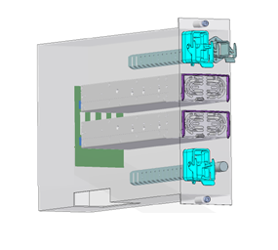
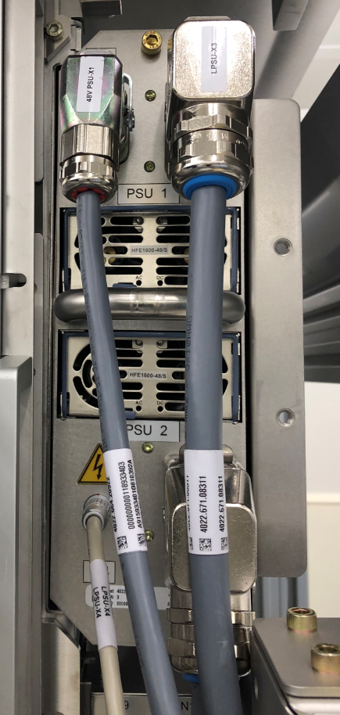
LPSU MK4
LPPS Power Supply Unit
48V Interface 1
Supply Voltage
PSU 1
PSU 2
Diagnostics
48V Interface 2
Notes:
Supply voltage comes from LPPS.
Two output voltage connector, each 48V (1200W)

Slide 6
LPSU
LPPS Power Supply Unit MK4 Differences w.r.t MK3
Difference | Reason | Effect on Factory and Field
2xPSU | To be able to supply the power needed by the new laser inside LPPS MK4
Additional Cables (extra 48V and diagnostics cable) | Improved Diagnostics and extra power need | Requires a parking bracket if LPPS MK3 is used instead.
Installation | Exceeding safety limit of 7.5 kg (total mass is 8.6) | LPSU should be taken apart and build in without PSUs.
Notes:
2xPSU is needed to supply the 2000W energy consumption of LPPS. (One PSU supplies 1200W)
We have an additional cable for the extra PSU, and also an additional diagnostics cable to have a feedback from the system if there is something wrong with the connections.
Effect for factory and field: PSUs and the housing of the LPSU should be separated before installation and they should be installed one by one. Because all together they exceed the safety limit for carrying units which is 7.5kg. Total mass is 8.6kg in this case.

Slide 7
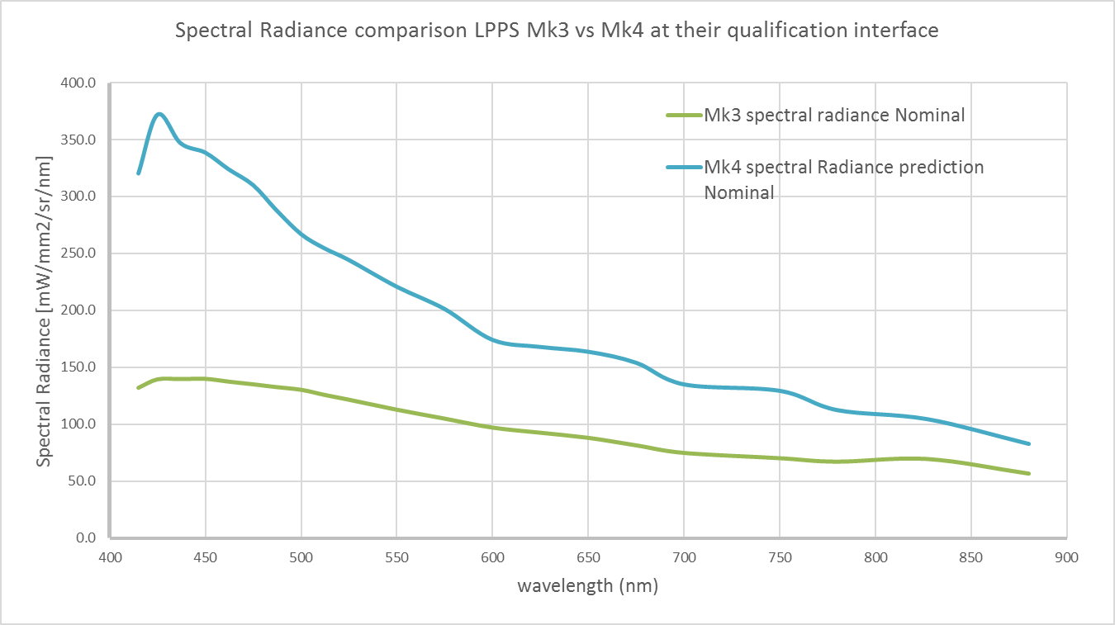
LPPS MK4
Why MK4?
Radiance Improvement Target: Factor 1.7
Notes:
For better performance (accuracy and speed) within the system, we need more light. Thus it was decided to have a better light source so LPPS MK4 is introduced.
First expectation was that it has more laser with factor of 1,7 w.r.t MK3.

Slide 8
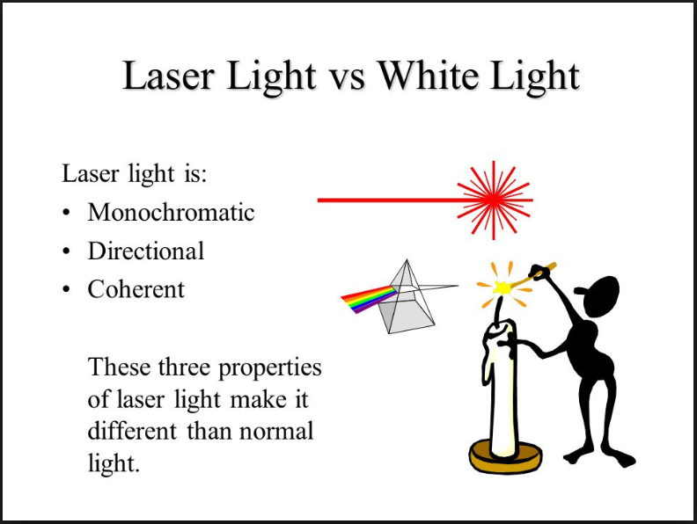
LPPS MK4
Laser vs White Light
Notes:
Now, I will start explaining how an LPPS operates, what it does and what the outcome is. BUT…
Before jumping into the working principle a little bit of reminder for definition of laser and white light.

Slide 9
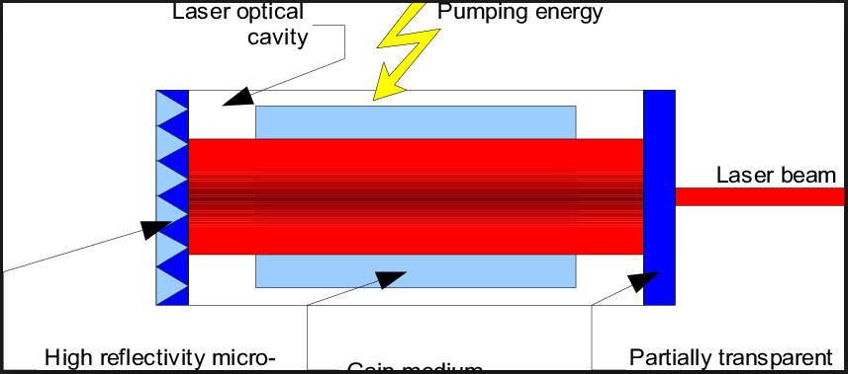
LPPS MK4
Laser Creation
Notes:
Laser Creation

Slide 10
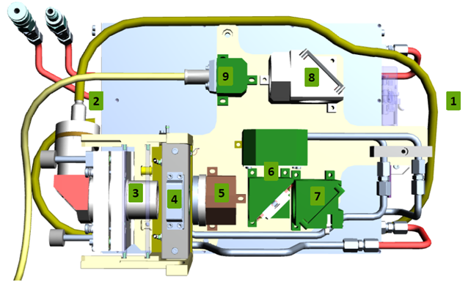
LPPS MK4
How it works?
Sequence
Laser creation
Laser transfer (QBH)
Focusing of laser
Creation of white light
Collection of light
Beam Dump
Alignment of light (mirror)
Alignment of light (mirror+focus)
Transfer of light
Laser
Notes:
Electrical Power is transferred to Light Power!
Laser source is on the bottom layer of LPPS. It creates 1070nm IR laser.
Fiber (1) will transmit the laser to the Focus Optics (3) defined by number 3. with the help of QBH connector (2)
Focus optics first improve the width of the laser and than focus the laser to QCM (Quick Change Module)
QCM has a special gas mixture inside and with the help of high electrical power, the laser light passing through the QCM is transformed to a white light. (GO TO THE NEXT SLIDE)
Collector optics take the light coming out of QCM and collimate it. So the photons are parallel w.r.t each other as much as they can be.
Beam dump is to take out the unwanted IR light that passed the QCM with the white light. Beam splitter will let the white light pass through and split the IR light to beam dump.
We have a couple of alignment mirrors which guides the light.
And we again take the light into the fiber. (LPPS to CL fiber)

Slide 11
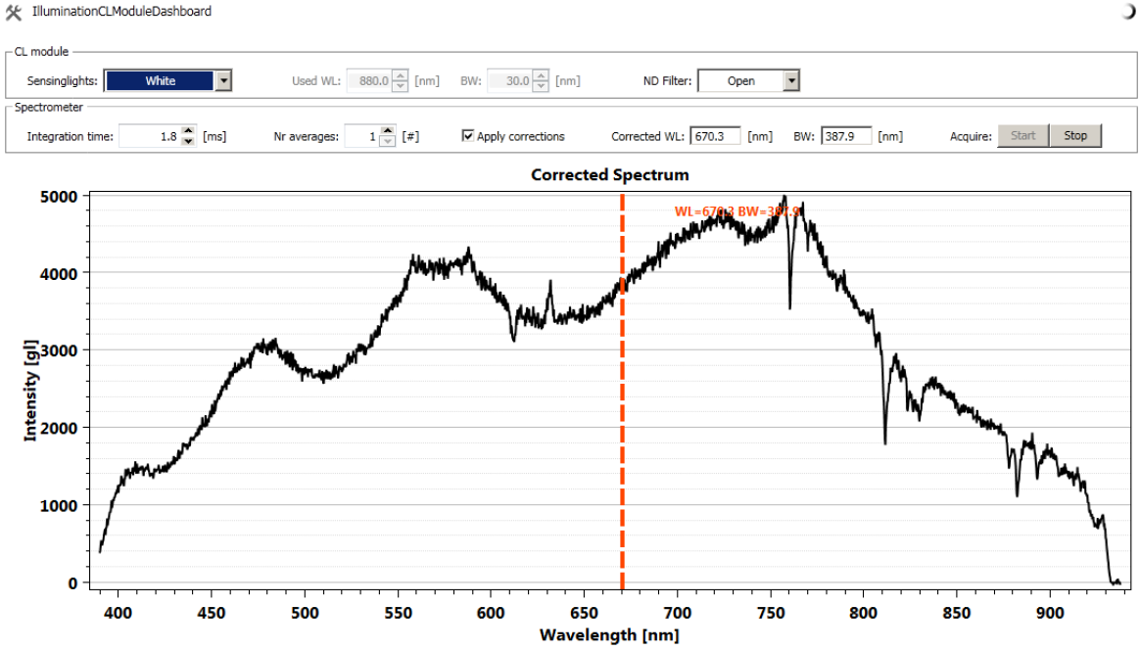
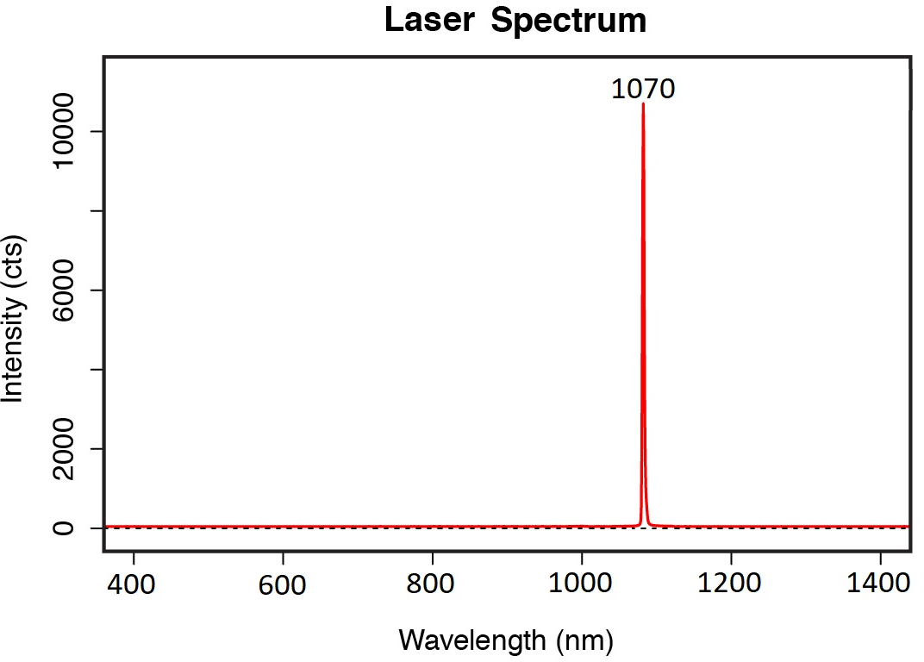
LPPS MK4
Before and after QCM
Before
After

Slide 12
LPPS MK4
Differences w.r.t MK3
Changed Item | Change from MK2/3 | Reason
Laser Focus Optics | Less optics | Higher transmission
Collector Optics | One of the optics | Better transmission
Coatings | Inner bulb coating IR coating | Reduce transmission losses Reduced heat load
Laser | Output power from 400W to 700W | More intensity
IR mirror + beam dump | New design | To extract the IR light
QCM | Additional cooling plate Operating hours counter | Better cooling
Starter Module | Connector positions | Serviceability improvement
Controller | Additional diagnostics | Better troubleshooting
1
2
3
4
5
6
7
8
Notes:
Laser focus optics have less optics, it helps more photons to pass through, more transmission. Side effect: Less room, so now it is small enough to reconnect the CL fiber without taking the starter module out first.
Collector optics lightly changed, the design of one of the optics.
Coating changes: Inner bulb coating, also IR coating
Laser power output is now 700W, it was 400W in the previous version. It has same volume.
IR mirror and beam dump is added: to extract the IR light.
QCM has additional cooling plate for better cooling and it also has operating hours counter. This counter is readable by the supplier.
Starter module connections are changed, serviceability is improved.
Controller has more diagnostics for better troubleshooting.

Slide 13
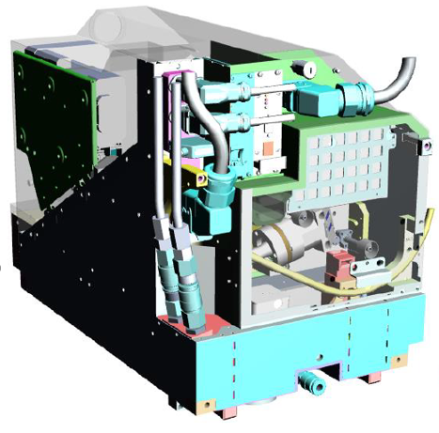
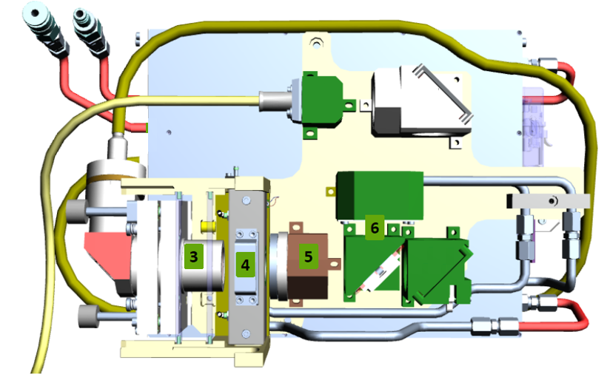
LPPS MK4
Differences w.r.t MK3
8
4
7
5
1
6
2
IR Mirror +
Beam Dump
Controller
Starter Module
Laser
QCM
Focus Optics
Collector Optics
Notes:
- This Slide shows the parts that are changed or added.

Slide 14
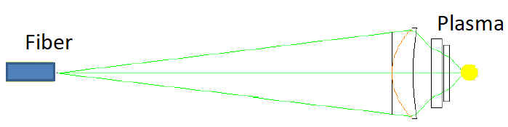
LPPS MK4
Difference 1- Laser Focus Optics
Function: transport and focusing of the Laser light from the fiber end into the plasma
Reduced number of lenses (3 instead of 11)
Side advantage: Removal of the starter module is no longer needed for installing or taking out the CL fiber! (This is mainly due to reduced number of lenses)
Focus
Optics

Slide 15
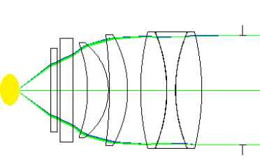
LPPS MK4
Difference 2- Collector Optics
Function: Transport of plasma emitted power to the fiber LPPS to CL module
Function: Transport residual Laser power to the beam dump
QCM
Collector Optics

Slide 16
LPPS MK4
Difference 3- Coatings
Inner bulb coating (Reduce transmission losses)
IR coating concept (Reduced heat load)

Slide 17
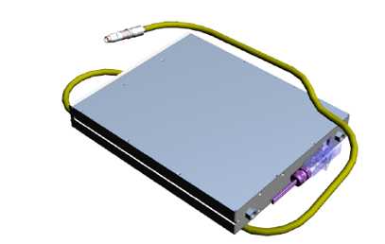
LPPS MK4
Difference 4- Laser
700W output (increased from 400W)
2000W Power consumption (Reason of 2 PSU requirement)
Connection to controller via RS232
No dimension change.

Slide 18
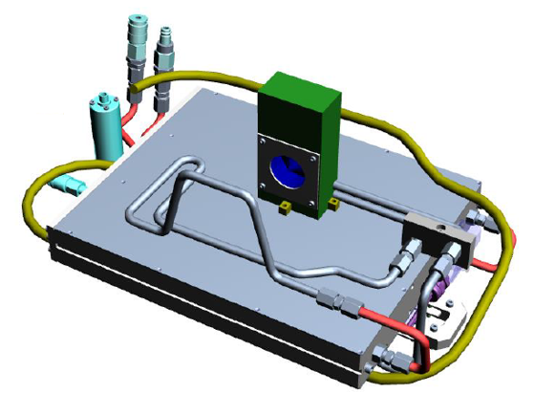
LPPS MK4
Difference 5- IR Mirror and Beam Dump (Not used at the end!)
Beam Dump
IR Mirror
Due to absence of IR coating, 200W of IR light has to be dumped.
Water cooled (identical cooling tubes with QCM)
Black coating with damage threshold of 500W/cm2
Turned out it was only 70W of IR light which can be absorbed with a coating!

Slide 19
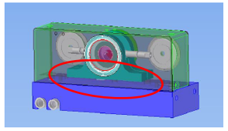
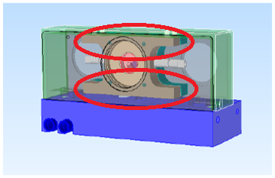
LPPS MK4
Difference 6- QCM
QCM MK2
(used for LPPS MK2 and MK3)
QCM MK4
Slightly different volume
Extra cooling plate
Pin in position is changed slightly (as a prevention to use MK2 version)
Different handle
Equipped with an operating hours counter (only readable at supplier)

Slide 20
LPPS MK4
Difference 6- QCM

Slide 21
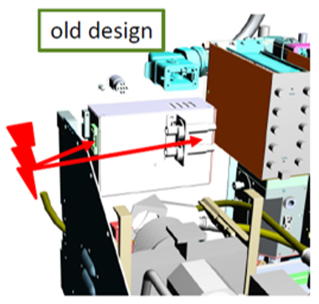
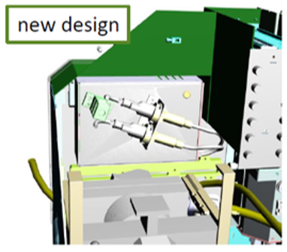
LPPS MK4
Difference 7- Starter Module
Accessibility to the connectors is increased
HV cable connectors are tilted
LEMU connector is moved to the backside
230V connector is moved to the backside
Electronics design is same
Connectors are all at the backside (due to lack of space)

Slide 22
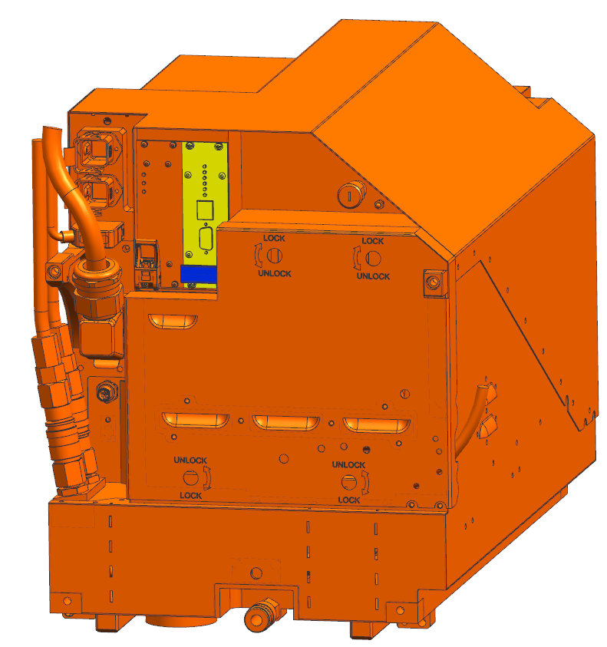
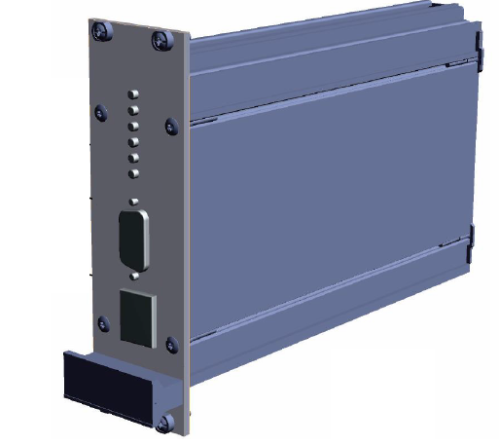
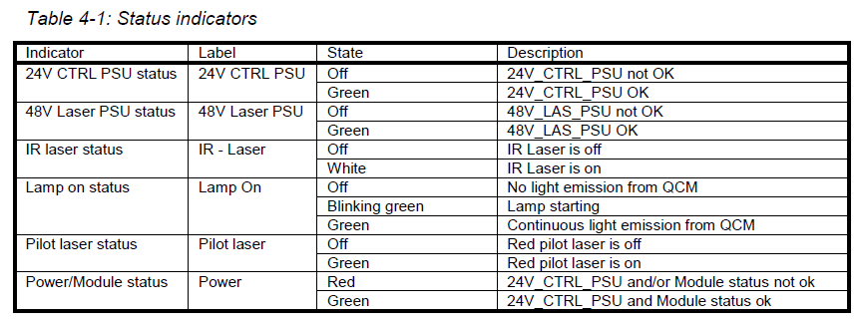
LPPS MK4
Difference 8- Controller
Controller
More diagnostics
Notes:
- By looking at the leds on the controller, you can see if there is a problem with the LPPS or not.

Slide 23
LPPS MK4
The Result for 1st LPPS MK4
Expected: 1.7
Achieved: 1.27
Long way to go!
Below improvements are done, 2nd LPPS MK4 arrived in the house at wk4.5, installed on a 375PEP machine, promising results but we still have some reliability issues.
Notes:
- The first LPPS arrived here 2 months ago. We did measurements to check if it is okay according to the specifications. It was not…

Slide 24
LPPS MK4
Improvements w.r.t. 1st LPPS MK4
New Coating for CL to Shutter Fiber
6
5
Focus Optics
1
4
2
3
Remove Beam Dump
New QCM
Collector
Optics
QCM
Coating
IR Concept
Notes:
Focus optics: slight design change
QCM will have Aluminum Oxide Al₂O₃
QCM IR coating: whole beam dump concept will change, basically a roll back to MK3 design in terms of IR light handling concept. IR coating will cause the QCM heated a bit more since it is going to be held there. Also there will be no beam dump part further ahead.
Collector optics design change will give us 4 percent improvement.
Still not there? New coatings will be applied to fiber tips of CL to Shutter fiber tips. This will improve the light intensity by 6 percent. It is originally without coating.

Slide 25
LPPS MK4
Issues during integration
P402512 - Leaking bulb issue
P402516 - QBH connector interlock
P402386 - Controller PSU OFF
High drift of QCM block temperature

Slide 26
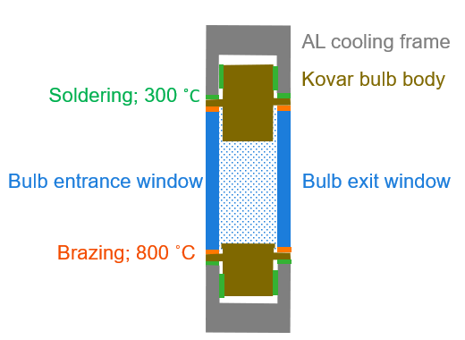
LPPS MK4
1 - Issues during integration - Leaking bulb issue (P402512)
Problem:
Hot leakers: QCM’s succesfully qualified, but slow leaking during operation
3x failures so far (2x Qio stress test, 1x ASML )
Cold leakers: 16% of QCM MK4 failed during qualification @ Qioptiq
Hot leakers not found by default LPPS/QCM qualification
Cause:
QCM/bulb design similar to MK3, but higher pressure / temperature
MK3 hot pressure is 80bar, MK4 is 120bar.
MK2 cold pressure is 25bar, MK4 is 35bar
Temperature @ window sleeved increased from 180deg (MK3) to 220deg (MK4)
Visual inspection on hot leakers show no molten soldering, nor damaged brazing (last is key for leak tightness)
Cause unclear. Failures seem temperature related, role of higher pressure is unclear
RCA not finished
Gas mix under high pressure
(cold 35, hot 120bar).

Slide 27
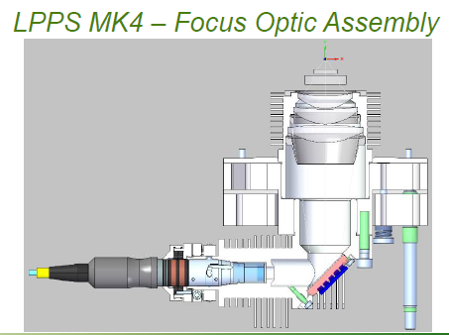
LPPS MK4
2 - Issues during integration - QBH connector interlock (P402516)
Problem:
LPPS has interlock safety circuit (safety)
After L3/L4 sensor encoder swap, LPPS not able to startup due to interlock error
Diagnose pointed out laser QBH connector is triggering interlock error
Cause:
Module returned to supplier. Analyses revealed issue w. QBH connector (part of laser)
After replacing laser (incl fiber+QBH) module OK again
Laser returned to IPG for RCA → 8d 1912?
Containment
Swap LPPS
Standardized high power laser connector (QBH) – part of interlock safety circuit)

Slide 28
LPPS MK4
3 - Issues during integration - Controller PSU OFF (P402386)
Problem:
Controller went off after power cycling of YMCR with circuit breakers on MSMR-TM.
This is done by switching off F1 and F4 circuit breakers. F5 is the circuit breaker of the LPPS (wrong switch?)
Cause:
Unknown, supplier is also working on it.
No machine time to reproduce the error and prove the hypothesis of wrong switch.
Containment
Full power cycle of the system.

Slide 29
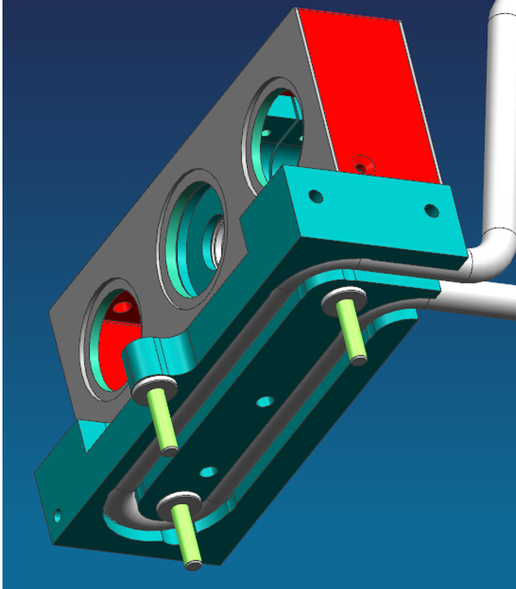
LPPS MK4
4 - Issues during integration - High drift of QCM block temperature
Problem:
QCM cooling block temp. increases over time (+7 to 15deg)
Settles after certain time
Imposes additional risk on bulb failures (already overheating)
Cause:
New MK4 thermal adhesive to connect waterpipes w. cooling block.
Hypothesis. Thermal glue between water lines & cooling block generate cracks due to thermal stress, incr. thermal resistance
Solution:
Fall back to MK2 glue adhesive
Thermal adhesive between water pipes and cooling block

Slide 30
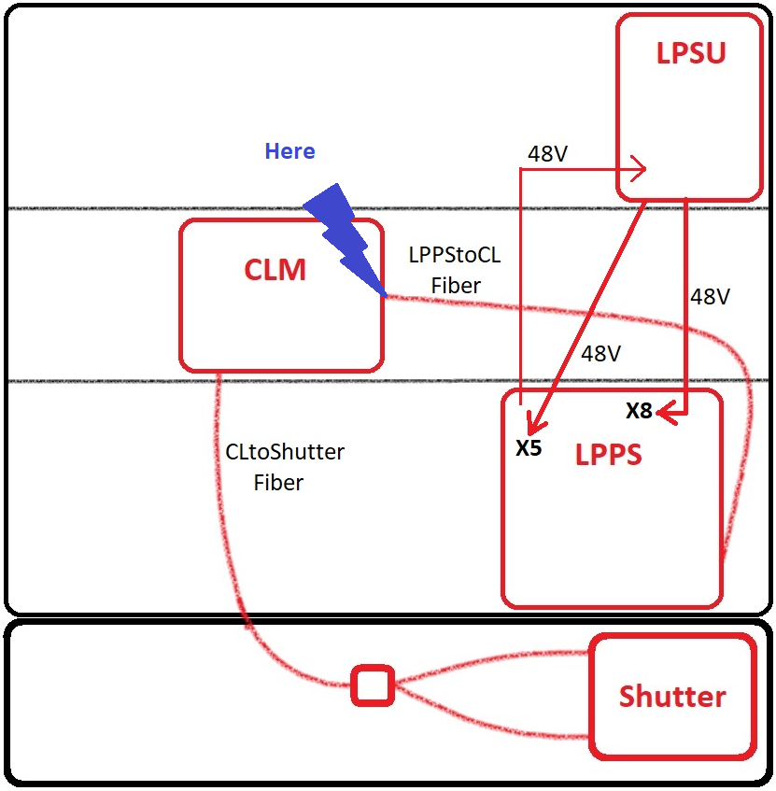
Where are we? What it looks like?
Notes:
- Just to remind you, now our photons are here!

Slide 31
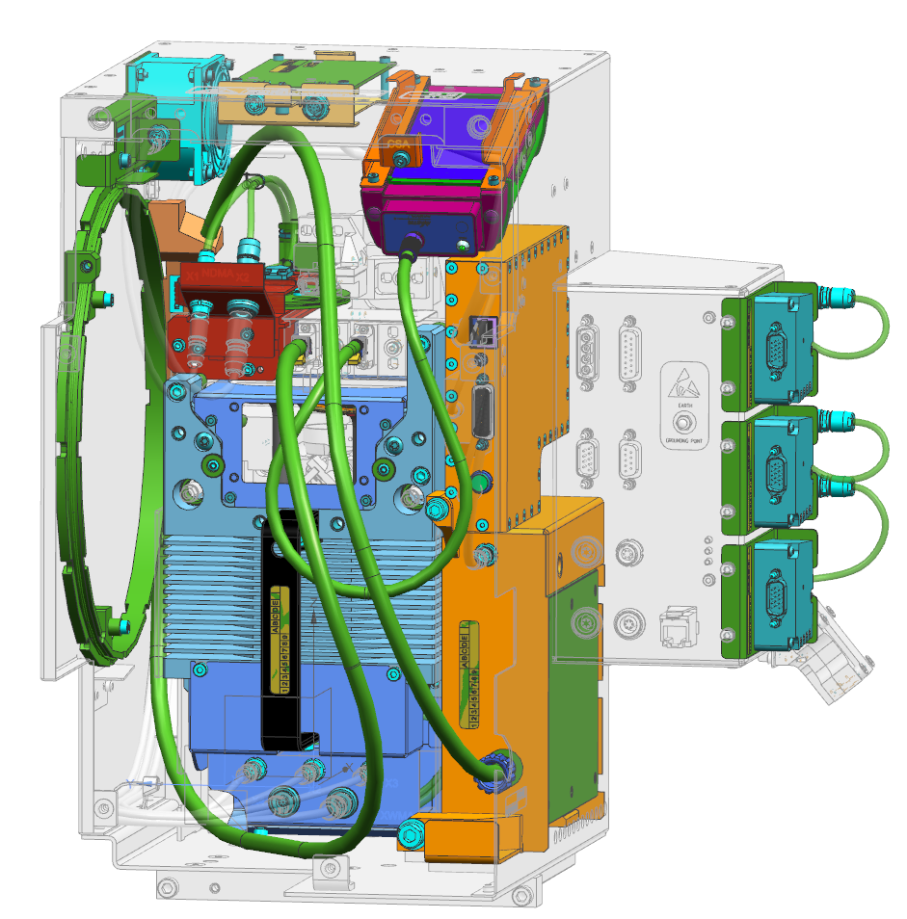
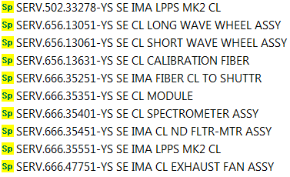
Spare Parts of CL Module
Converter PCA assy
Exhaust fan assy
Calibration source
ND Motor Assy (5 ND filters)
Interpolators
Short/Long wave wheel assy
Calibration source fiber
XWP MOTOR ASSY
Spectrometer + fiber
Notes:
- Just to remind you, now our photons are here!

Slide 32
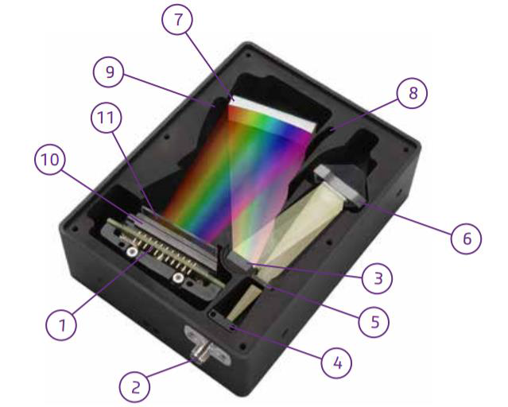
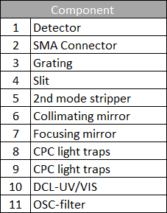
Spectrometer

Slide 33
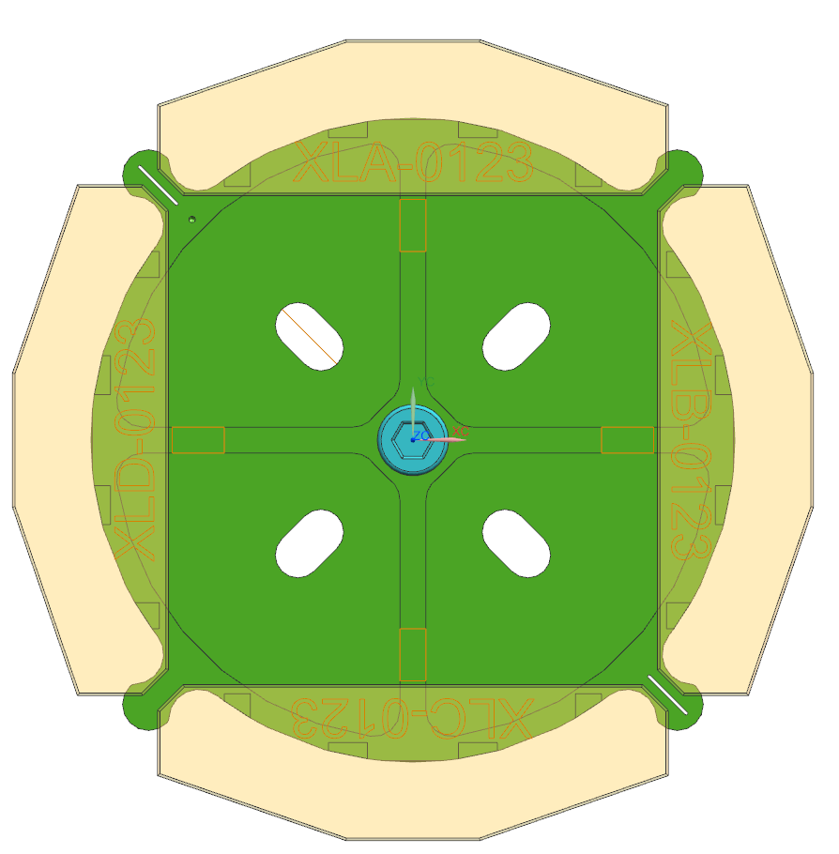
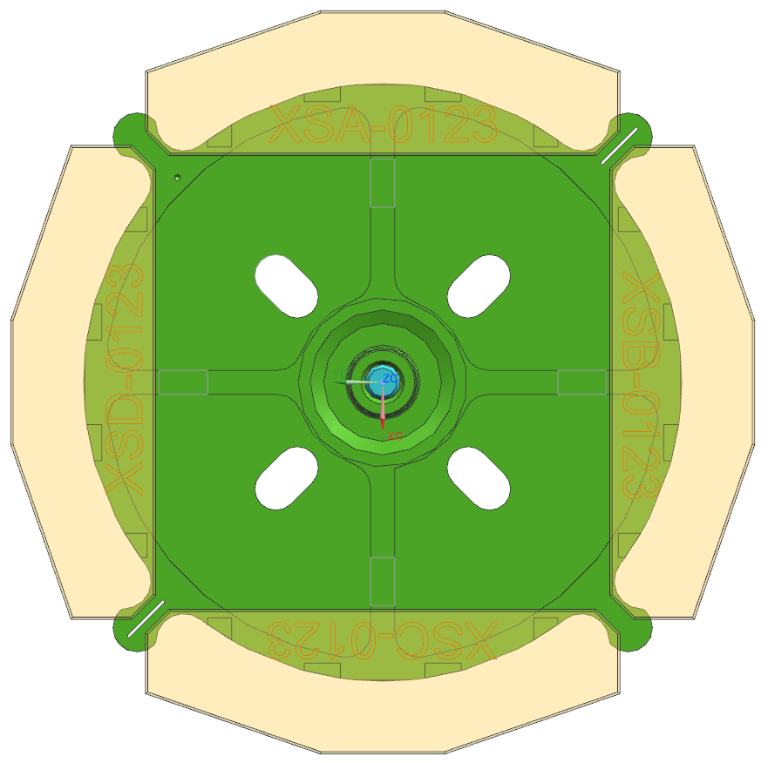
Nominal wavelength positions on filter wheel
With geometrical tolerances
LWP
SWP
2mm
2mm
410nm
410nm
≅531nm
≅531nm
5mm
5mm
895nm
895nm
652.5nm
652.5nm
652.5nm
652.5nm
5mm
5mm
≅774nm
≅774nm
2mm
2mm
652.5nm
652.5nm

Slide 34



CL Module (Continuous Lambda Module)
LPPS
Spectrometer
Mixing fiber
Y
H
Z
Cal. source
V
F1
F2
F3
F4
OPTICAL BASE FRAME
L1
L6
L5
≅ 4%
L4
M2
BS2
L2
L3
ND1
5x ND
1x open
3x spare
M1
≅4%
M3
BS1
LWP
SWP
ND2
MOTOR FRAME
Notes:
Helps us to pick the desired color from the wide white light spectrum
LPPS fiber brings the light in
Optics guide the white light to 2 filters. These filters let the photons that have desired/asked wavelength to pass through. So now after the XWP Assy (contains LWP and SWP) we actually have a color (not white light anymore)
4 percent of the colored light is guided to the spectrometer. It checks the intensity and the wavelength accuracy of the light. It is important component.
Calibration source is used by the calibration tasks for spectrometer which we will have a brief look later on.
The most part of the colored light is guided to ND filters and the light passes through those filter than is again guided to the output of the Cl module and finally to the CL to Shutter box fibers.

Slide 35
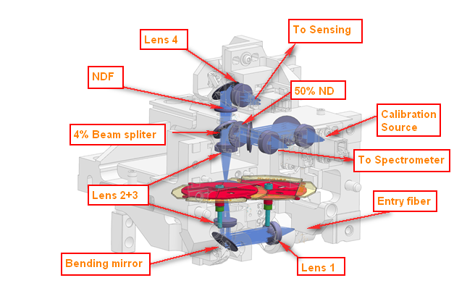
CL Module
Creation of color

Slide 36
SWP (Short Wave Pass) and LWP (Long Wave Pass)
How they work?
SWP
LWP
Notes:
SWP short wave pass, lets the photons that have shorter wavelength than the filter value which is adjustable. (in accordance with the selected wavelength)
LWP long wave pass, lets the photons that have longer wavelength than the filter value which is also adjustable.

Slide 37
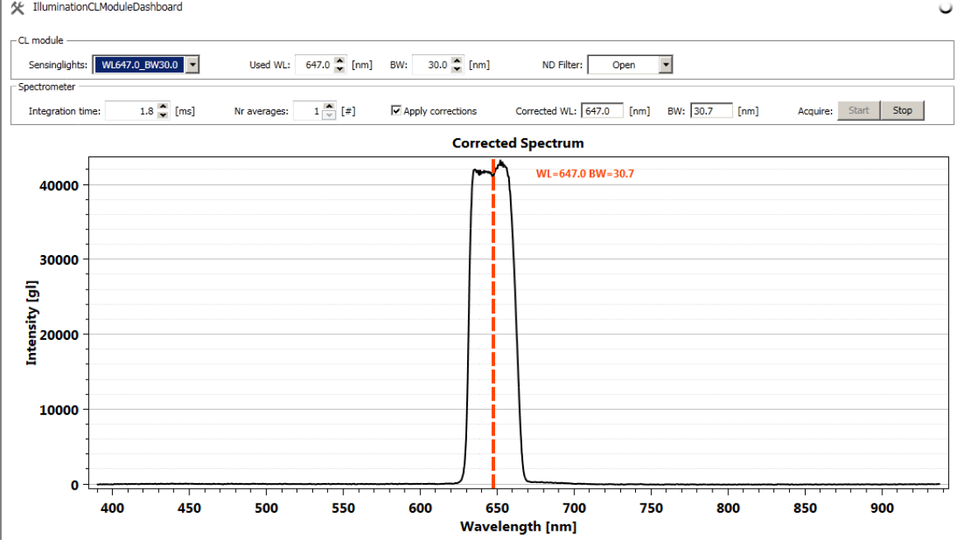
SWP and LWP
How they work?

Slide 38
SWP and LWP
How they work?
Fun time!
Closer live look with groups of five.

Slide 39
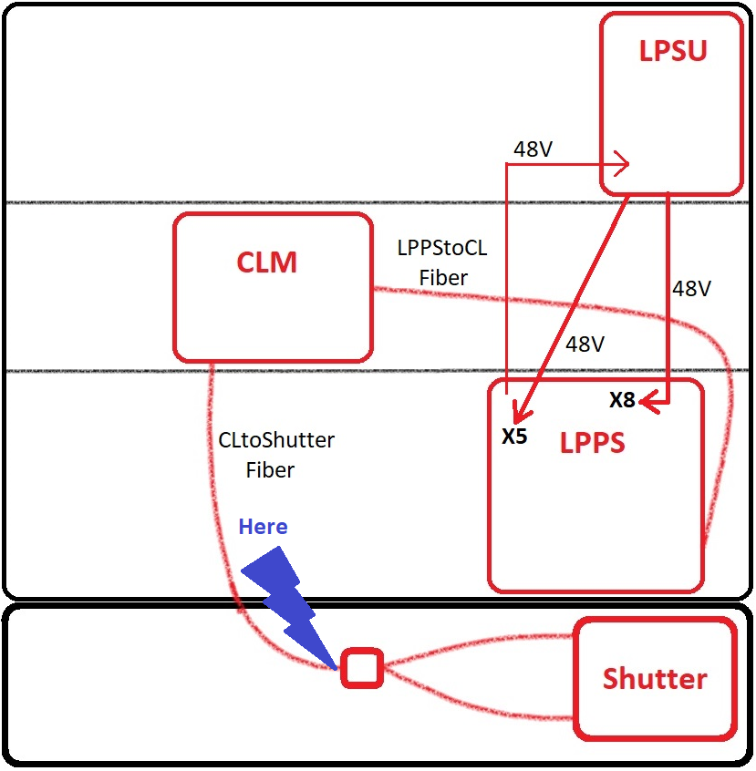
Where are we? What it looks like?
Notes:
Finally our photons are out of the CL Module (not all) as we selected a certain CW (central wavelength) with a certain BW (bandwidth)
Transferred to the shutter box without any change, they only get doubled here.

Slide 40
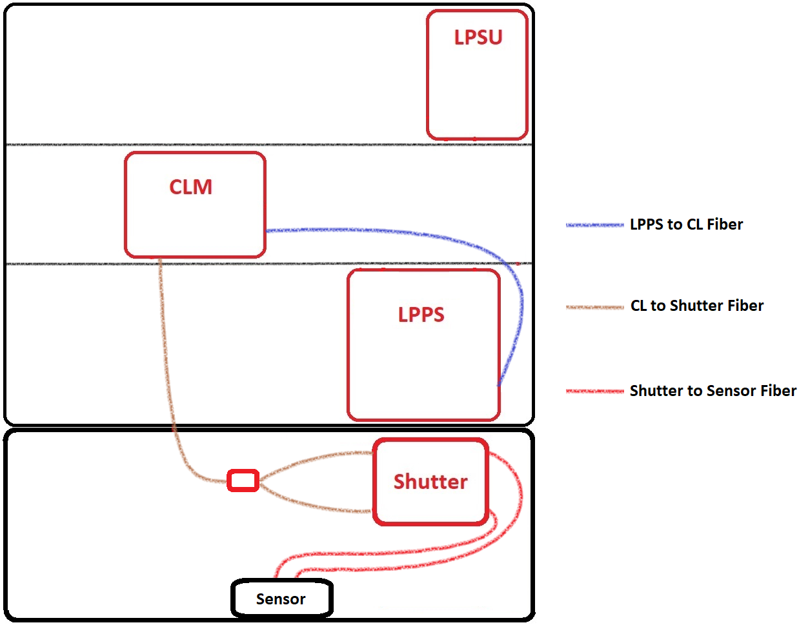
Fibers
Fiber Path
Notes:
Fibers carry the photons within the system and in between source units.
3 main fibers paths.

Slide 41
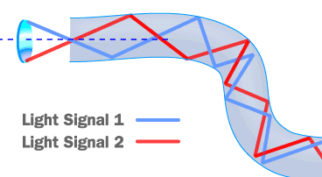
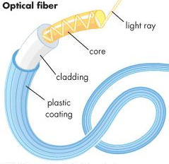
Fibers
How it works
Notes:
The photons are reflected by the inner side of core element of the fiber. Core is either glass or highly reflecting plastic.
Cladding helps the light to stay within the fiber. Confines it so it does not get out.
Plastic cover is for protection purposes.
Fibers are sensitive material.

Slide 42
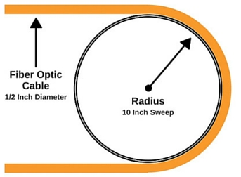
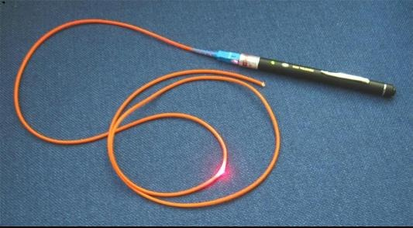
Fibers
Avoiding Fiber Damage – Bending radius
Notes:
- Do not bend more than the bending radius lets you.

Slide 43
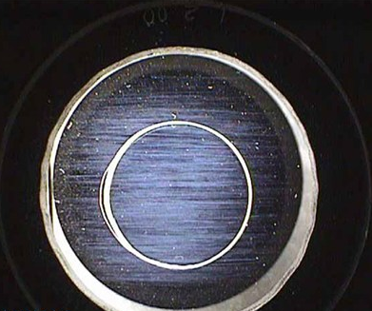
Fibers
Avoiding Fiber Damage – Fiber tip damage
Less light transmittance
More integration time
Less performance!
Note that there is also a high possibility of degradation over time since this area will be affected by high amount of light!
Notes:
- Scratches will gradually eventually decrease the transparency of the tip. The light passing over the scratch will make it worse and worse, it may even cause a light burn and in this case it will get bigger even faster.

